Slide 1


Atliq Hardwares
Ad-Hoc Insights:
Consumer Goods
Presented by
Gomathi Latha

Slide 2

COMPANY OVERVIEW
OBJECTIVES
Atliq Hardwares (imaginary company) is a leading computer hardware producer in India, with a growing presence in international markets. The company specializes in providing high-quality hardware products, catering to both individual consumers and businesses.
To deliver insights for ad hoc requests through SQL analysis.

Slide 3
About Data
dim_customer
dim_product
fact_gross_price
Sales transaction data from Atliq Hardware spans from September 1, 2019, to August 1, 2021. The company operates on a fiscal year basis, with September serving as the start of the year.
Atliq Hardware sells products across various segments, including peripherals, accessories, notebooks, desktops, storage, and networking, and operates in regions such as APAC, LATAM, North America, and Europe.
customer-related data
product-related data
gross price information for each product
fact_sales_monthly
fact_manufacturing_cost
fact_pre_invoice_deductions
cost incurred in the production of each product
pre-invoice deductions information for each product
monthly sales data for each product.

Slide 4

Ad-Hoc Requests

Slide 5


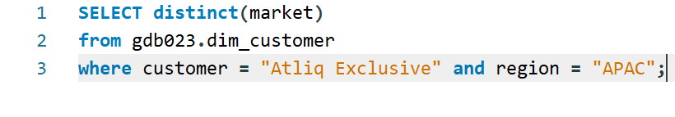
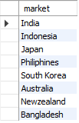

1. Provide the list of markets in which customer "Atliq Exclusive" operates its business in the APAC region.
QUERY
RESULT

Slide 6




Key Finding:
Atliq Exclusive operates in 8 APAC markets: India, Indonesia, Japan, Philippines, South Korea, Australia, New Zealand, and Bangladesh.
Insight:
This wide market presence provides opportunities for growth across various economies.
Recommendation:
Focus on localized marketing strategies to strengthen presence in high-potential markets like India and South Korea, leveraging unique needs in each country.

Slide 7
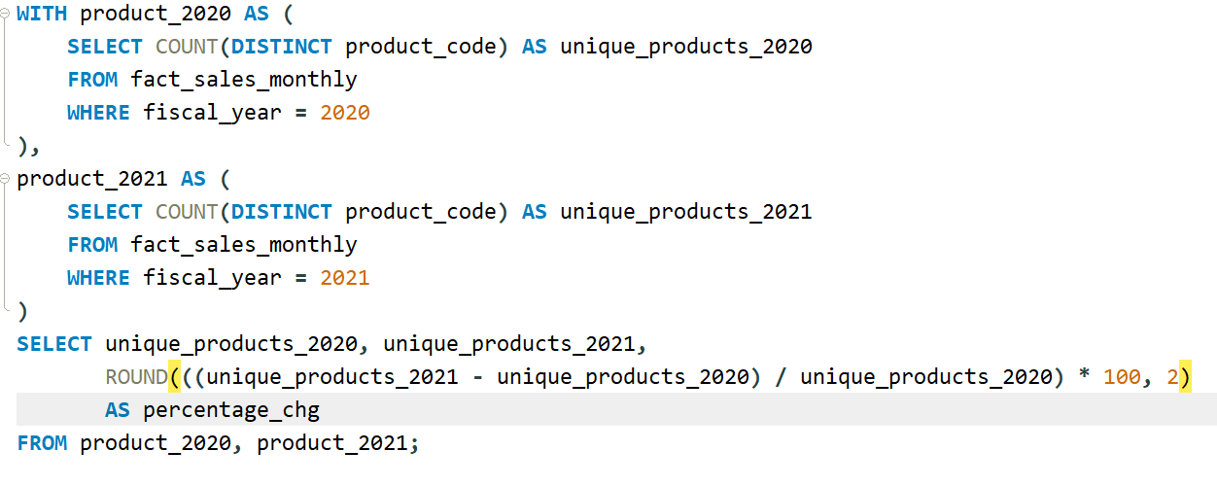
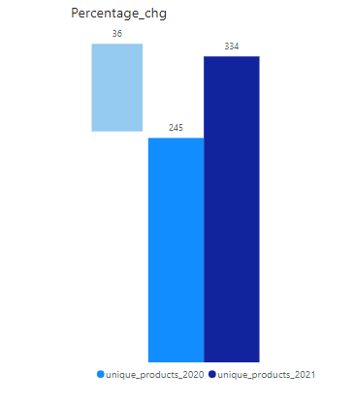

2. What is the percentage of unique product increase in 2021 vs. 2020?
QUERY
RESULT

Slide 8
Key Finding:
Unique products increased by 36.33% from 245 in 2020 to 334 in 2021.
Insight:
This growth indicates a successful product development strategy.
Recommendation:
Continue to invest in product innovation while analyzing market demand to avoid saturation. Focus on promoting the newer products to ensure they gain traction in the market.

Slide 9
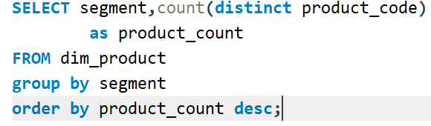
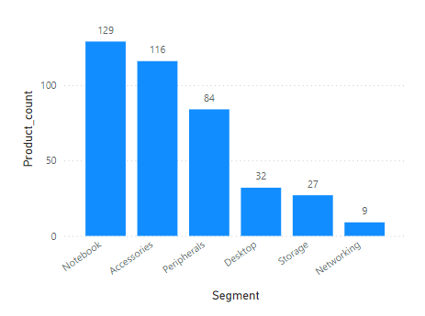
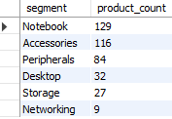
3.Provide a report with all the unique product counts for each segment and sort them in descending order of product counts.
QUERY
RESULT

Slide 10
Key Finding:
The Notebook and Accessories segments have the highest number of unique products (129 and 116, respectively), followed by Peripherals.
Insight:
These segments are clearly performing well and contributing significantly to the product portfolio.
Recommendation:
Maintain a strong focus on these segments while identifying opportunities to expand product variety in the Desktop and Storage segments, where product counts are lower.

Slide 11
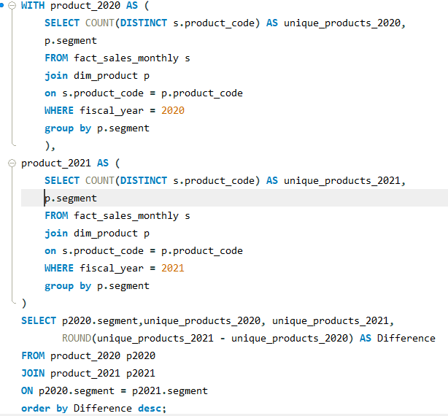
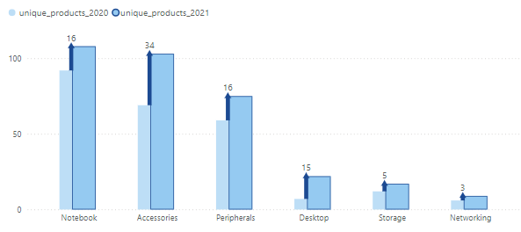
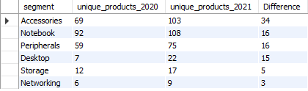
4. Follow-up: Which segment had the most increase in unique products in 2021 vs 2020?
QUERY
RESULT

Slide 12
Key Finding:
The Accessories segment saw the highest growth, with 34 additional unique products in 2021, followed by the Notebook segment.
Insight:
Accessories are showing strong performance, likely driven by increasing demand for peripheral gadgets.
Recommendation:
Consider increasing marketing efforts around accessories and bundling them with notebooks or desktops to maximize sales potential.

Slide 13
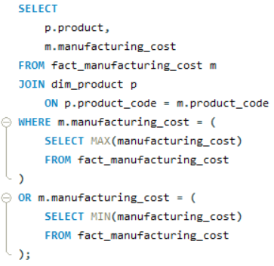

5. Get the products that have the highest and lowest manufacturing costs.
QUERY
RESULT
Highest Manufacturing Cost.
AQ HOME Allin 1 Gen 2 $240.54
Lowest Manufacturing Cost.
AQ Master wired x 1 Ms $0.892

Slide 14
Key Finding:
The product with the highest manufacturing cost is priced at ₹240.54, while the lowest is ₹0.89.
Insight:
There’s a wide disparity in manufacturing costs across products, which could reflect differences in complexity or material use.
Recommendation:
Ensure that high-cost products are priced appropriately to maintain margins. Review low-cost products to assess profitability and determine if pricing adjustments are needed.

Slide 15
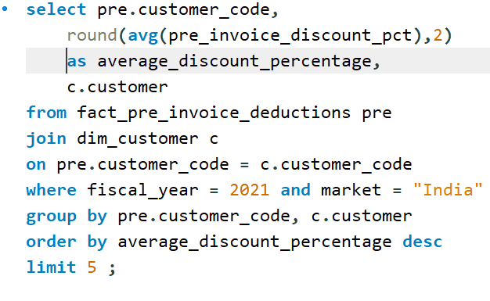
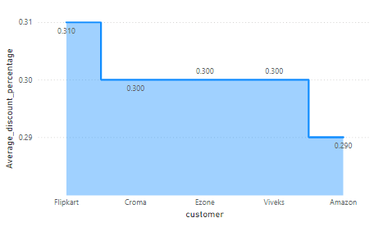
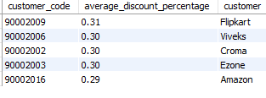
6.Generate a report which contains the top 5 customers who received an average high pre_invoice_discount_pct for the fiscal year 2021 and in the Indian market.
QUERY
RESULT

Slide 16
Key Finding:
Top customers receiving high pre-invoice discounts include Flipkart (0.31%), Viveks, Croma, Ezone, and Amazon.
Insight:
These top retailers enjoy considerable discounting, suggesting their strategic importance.
Recommendation:
Monitor the profitability of these discounts and explore opportunities to renegotiate terms where possible, particularly for high-volume customers like Flipkart and Amazon.

Slide 17
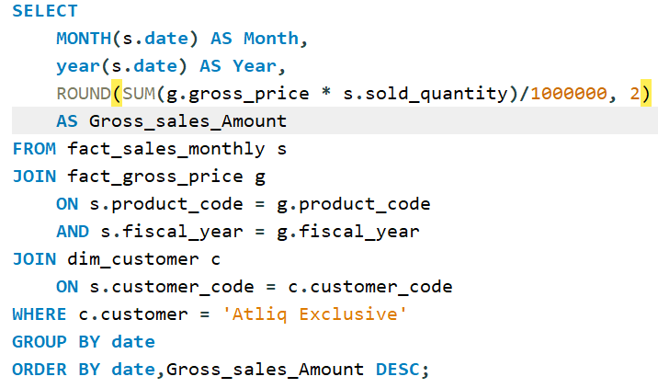
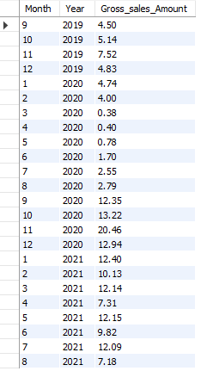
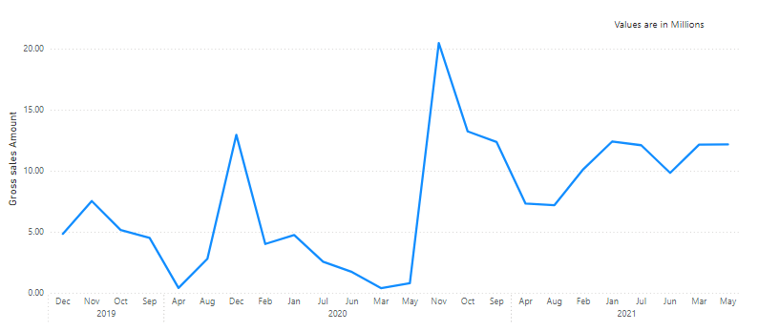
7. Get the complete report of the Gross sales amount for the customer “Atliq Exclusive” for each month .
QUERY
RESULT

Slide 18
Key Finding:
Peak Sales: The highest monthly gross sales amount occurred in November 2020 (20.46 million).
Low Sales: The lowest sales occurred in March 2020 (0.38 million), which could indicate the impact of early COVID-19 pandemic restrictions.
Recovery: There is a significant recovery and surge in sales from September 2020 onwards, indicating possible promotions or an economic rebound.
Insight:
The company experiences strong seasonal demand, particularly in Q4.
Recommendation:
Prepare marketing and supply chain strategies well in advance for Q4, ensuring inventory availability and promotional campaigns to capitalize on peak demand periods.

Slide 19
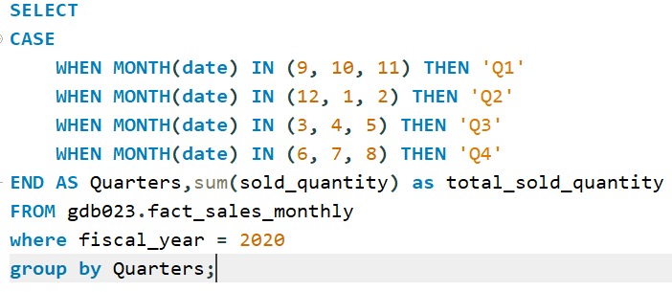
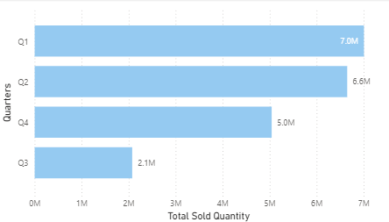

8.In which quarter of 2020, got the maximum total_sold_quantity?
QUERY
RESULT

Slide 20
Key Finding:
Q1 2020 had the highest total sold quantity with 7,005,619 units, making it the best-performing quarter of the year.
Q3 2020 saw a significant drop in sold quantities, with only 2,075,087 units sold, indicating the lowest performance.
Insight:
Retailer Q1 dominance: The high sales in Q1 might be driven by strong consumer demand post-festive season, year-end sales, or product launches.
Q3 decline: The sharp drop in Q3 could be attributed to factors like seasonality, economic downturns, or supply chain disruptions, potentially linked to the pandemic.
Recovery in Q4: Sales recovery in Q4 indicates that the market may have bounced back toward the end of the year, possibly due to strategic promotions, increased consumer confidence, or easing of lockdown restrictions.
Recommendation:
Leverage high-performing periods: To capitalize on strong sales in Q1, the company could consider ramping up marketing and stock in preparation for the start of the year, tapping into the post-holiday consumer spending.
Address Q3 challenges: Analyze the causes of the Q3 decline, whether it's seasonality, consumer demand, or external factors. Consider diversifying product offerings or launching promotions to mitigate future drops.

Slide 21
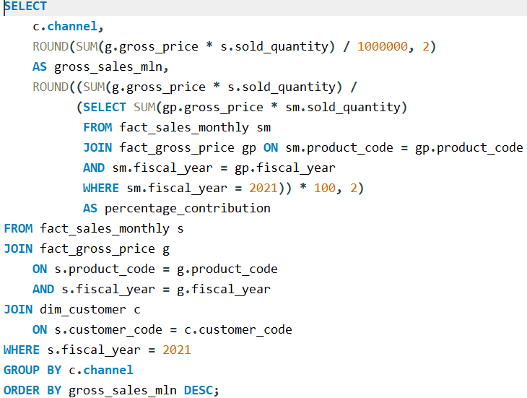
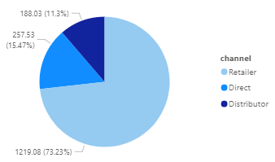

9. Which channel helped to bring more gross sales in the fiscal year 2021 and the percentage of contribution?
QUERY
RESULT

Slide 22
Key Finding:
The Retailer channel contributed 73.23% of gross sales, far outpacing Direct and Distributor channels.
Insight:
Retailer partnerships are driving a significant portion of sales, which highlights their importance.
Recommendation:
Strengthen relationships with retail partners by providing exclusive deals and marketing support. Explore ways to boost the Direct channel, which offers higher margins.

Slide 23
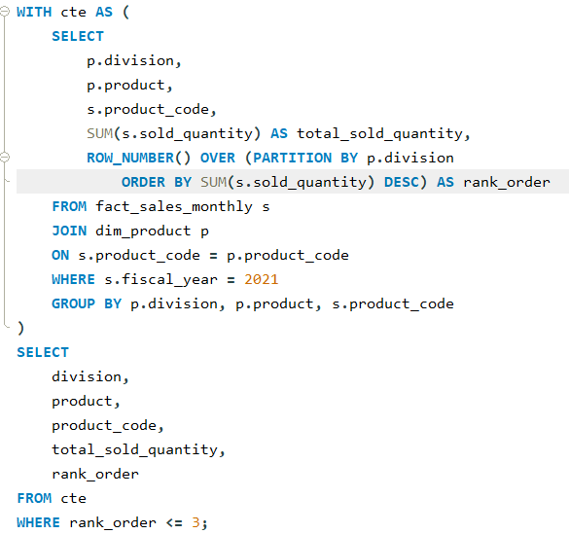
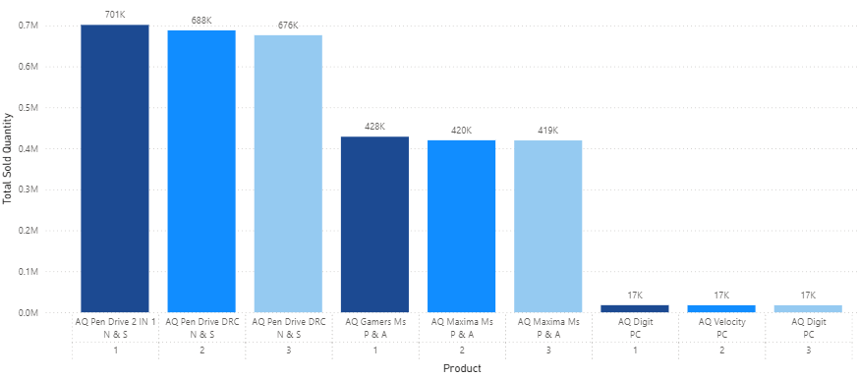
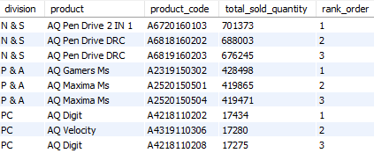
10. Get the Top 3 products in each division that have a high total_sold_quantity in the fiscal_year 2021?
QUERY
RESULT

Slide 24
Key Finding:
In Networking & Storage, the top-selling product was AQ Pen Drive 2 IN 1 (701,373 units). In Peripherals & Accessories, AQ Gamers Ms led sales (428,498 units).
Insight:
These top products demonstrate strong consumer demand and can be used to define future product lines.
Recommendation:
Focus R&D efforts on improving these top-performing products and create marketing campaigns around their success stories. Consider developing complementary products to increase average transaction values.

Slide 25
Thank you

